Slide 1
Paging And Page Replacement Algorithms
Instructor
Saba Naseem
saba.naseem@nu.edu.pk

Slide 2
Objectives
Paging
Page Fault
Page replacement Algorithms
Global and Local Replacement

Slide 3
Paging
A memory management scheme
OS reads data from hard disk in blocks called Pages – fixed size
Each used page can be in hard disk or in a page frame in RAM
Physical region of memory (RAM) containing a single page is Frame
Notes:
In Operating Systems, Paging is a storage mechanism used to retrieve processes from the secondary storage into the main memory in the form of pages. The main idea behind the paging is to divide each process in the form of pages.

Slide 4
Page Replacement
Decides which memory page is to be replaced
Swap out
All about determining the page number which needs to be replaced in order to make space for the requested page
Page replacement is done when the requested page is not found in the main memory (page fault).

Slide 5
Page fault
When a page requested by program is not available in memory
Results in application shut down
OS must take control and handle the page fault, it should:
Determine the location of data in hard disk
Obtain empty page frame
Load requested data into the frame
Update the page table
Return control to the program – invisible to user

Slide 6
Need for Page Replacement
When all page frames are non empty in RAM
Efficient paging system must determine the frame to empty
By choosing one that is least likely to be used or needed
Limited physical memory -> limited no. of frames -> limited no. of frame allocated to a process
Solution:
PAGE REPLACEMENT

Slide 7
Goal of Page replacement Algorithm
Provide lowest fault rate

Slide 8
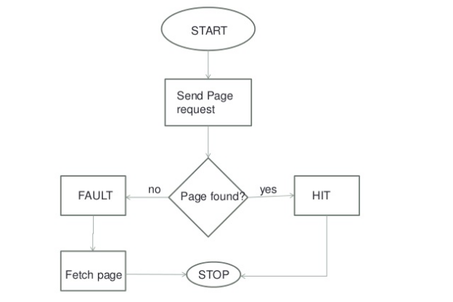

Slide 9
Replacement Algorithms
First In First Out (FIFO)
Optimal Replacement (OPT)
Least Recently Used (LRU)
Not Recently Used (NRU)
Second Chance
Not Frequently Used (NFU)
Random Replacement
Working Set Replacement
Counting Replacement

Slide 10
First-In First-Out (FIFO)
Pages in main memory are kept in a list
Newest page is in head and the oldest in tail
Treats page frames allocated to a process as a circular buffer:
When a buffer is full, the oldest is replaced.
Hence first-in, first-out
A frequently used page is often he oldest, so it will be repeatedly paged out by FIFO
Simple to implement:
Requires only a pointer that circles through the page frames of process

Slide 11
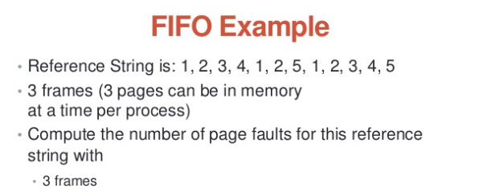
FIFO

Slide 12
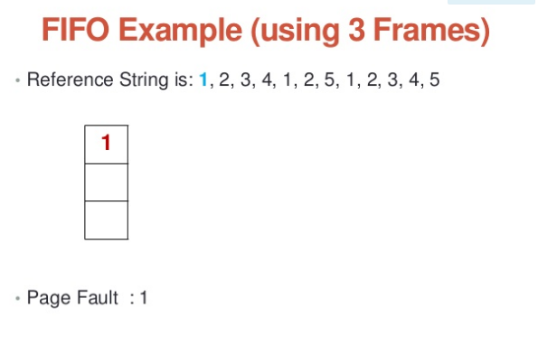

Slide 13
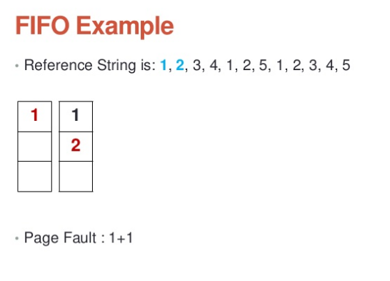

Slide 14
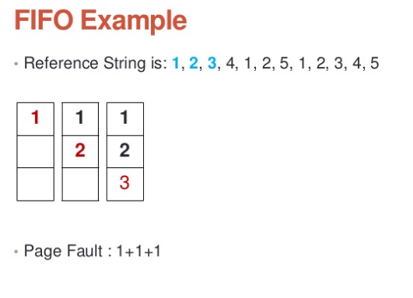

Slide 15
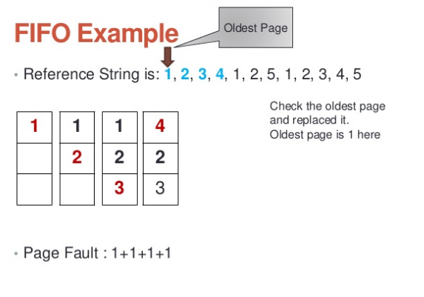

Slide 16
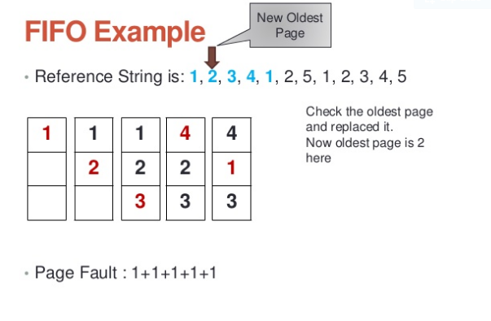

Slide 17
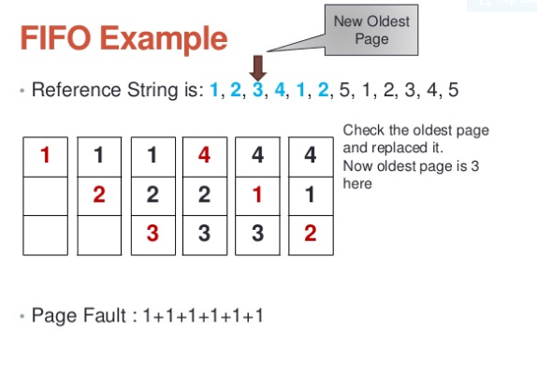

Slide 18
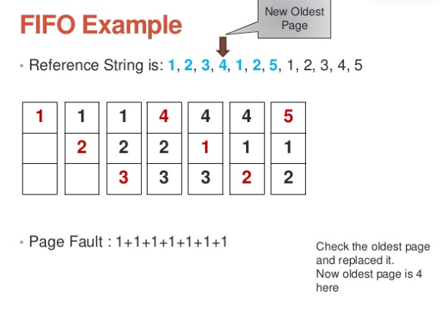

Slide 19
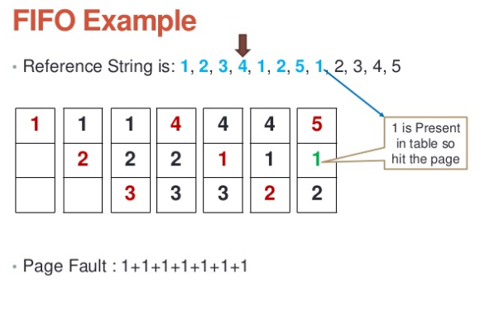

Slide 20
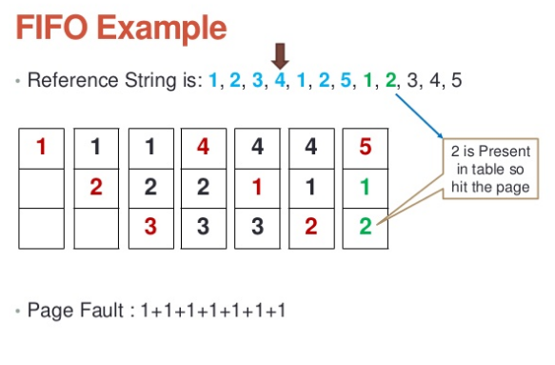

Slide 21
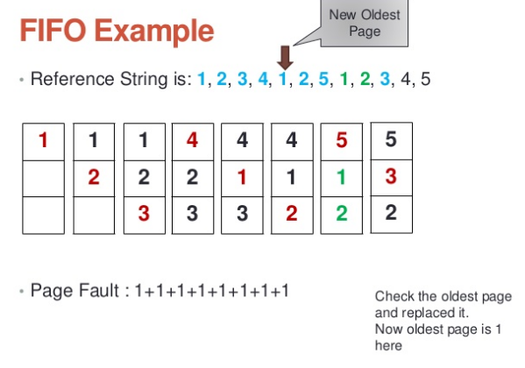

Slide 22
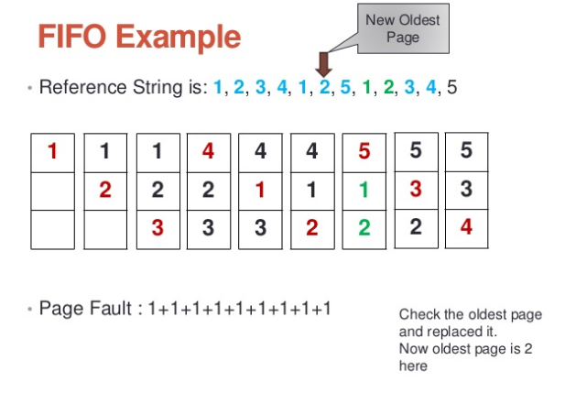

Slide 23
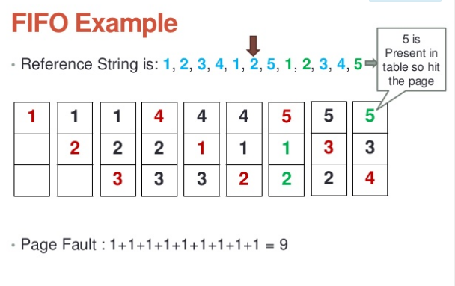

Slide 24
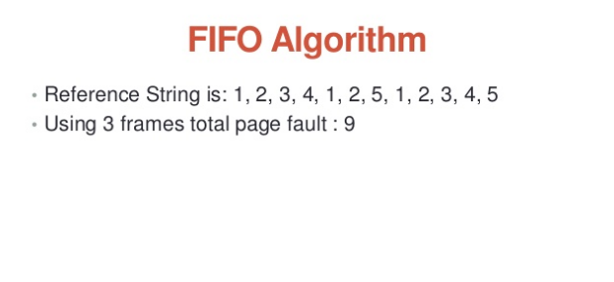

Slide 25
Drawbacks of FIFO-PR
A page which is being accessed quite often may also get replaced
Ignores locality of reference.
A page which was referenced last may also get replaced, although there is high probability of it’s need
Performance is not always goo d
Suffers from Belady’s Anomaly
Page fault increases with increase in number of frames
Thus, it is rarely used in its unmodified form

Slide 26
FIFO
Advantage:
Easy to implement
Disadvantage:
page in memory the longest may be often used
This algorithm forces pages out regardless of usage
Usage may be helpful in determining which pages to keep

Slide 27
Optimal Page Replacement
An optimal page replacement algorithm has the lowest page-fault rate of all algorithms and will never suffer from Belady’s Anomaly
Such algorithm does not exist and has been called OPT or MIN.
It replaces the page that will not be used for the longest period of time
Use of this page replacement algorithm guarantees the lowest number possible page fault for a fixed number of pages

Slide 28
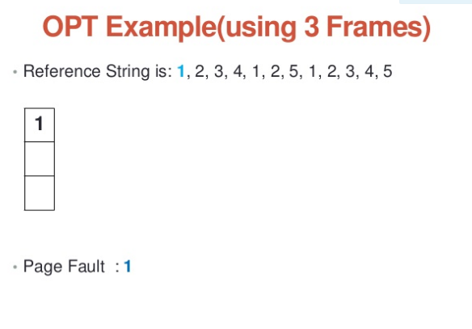

Slide 29
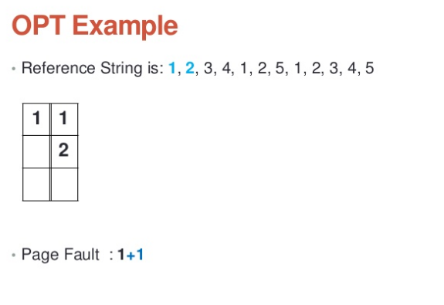

Slide 30
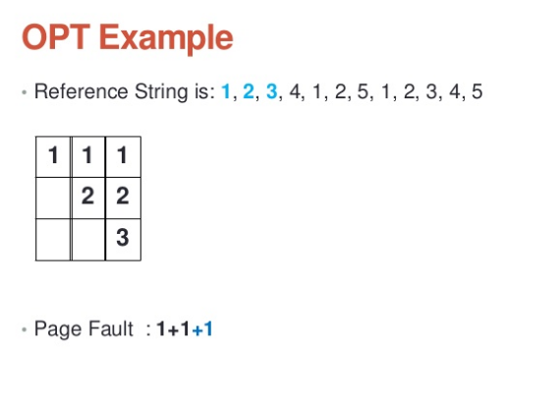

Slide 31
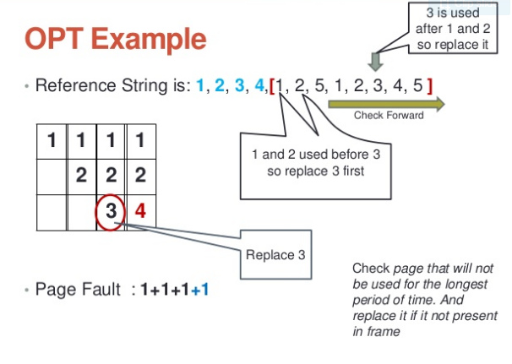

Slide 32
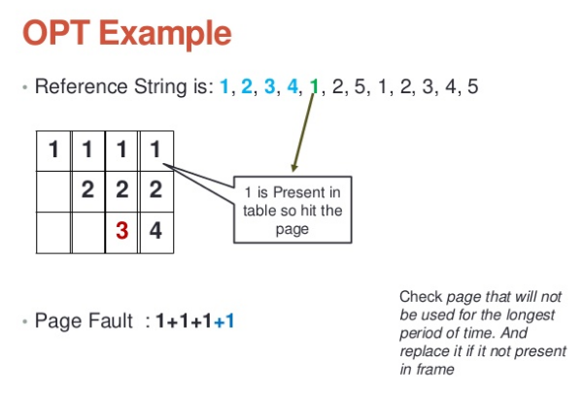

Slide 33
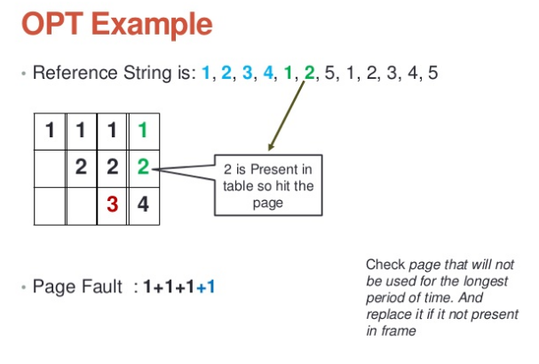

Slide 34
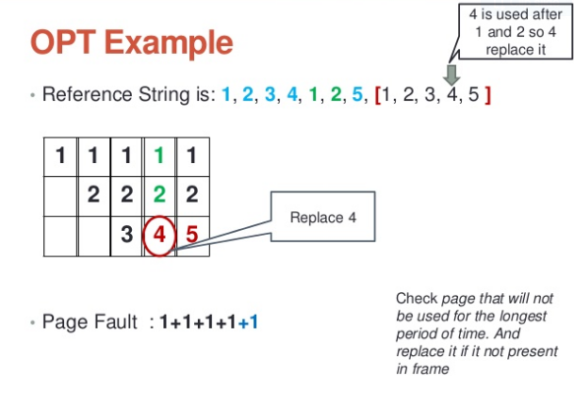

Slide 35
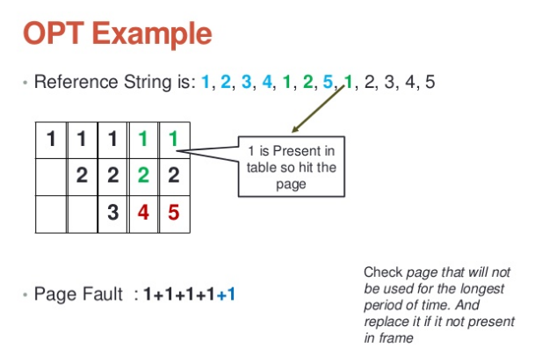

Slide 36
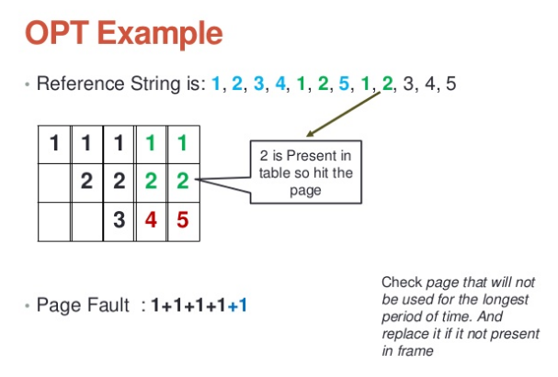

Slide 37
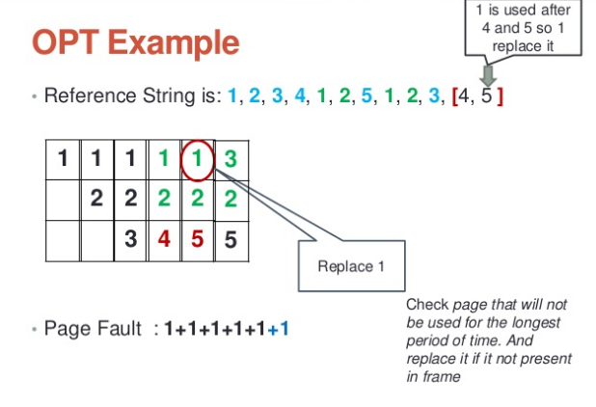

Slide 38
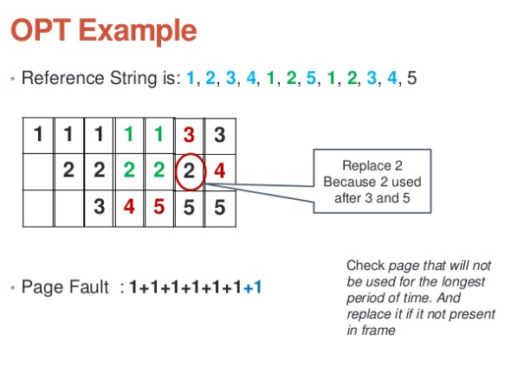

Slide 39
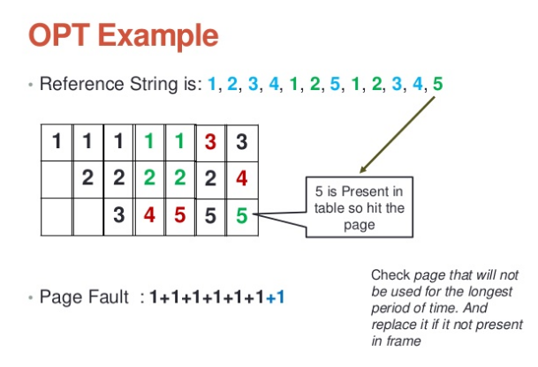

Slide 40
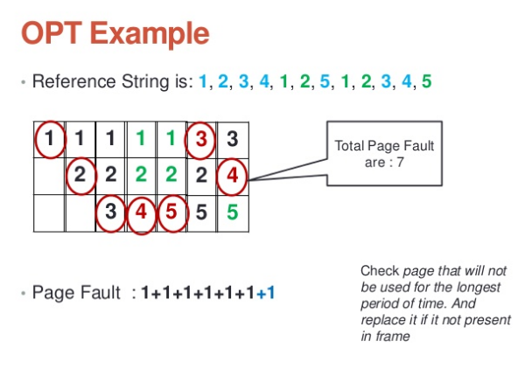

Slide 41
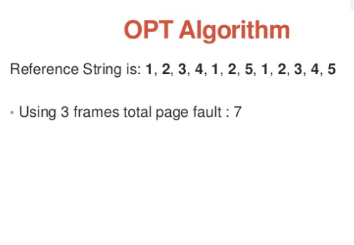

Slide 42
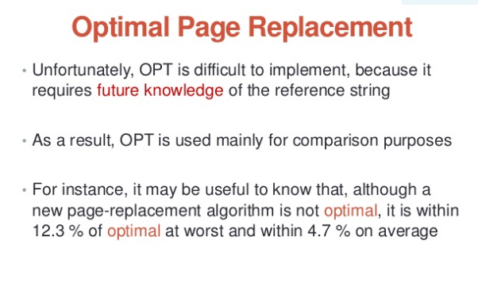

Slide 43
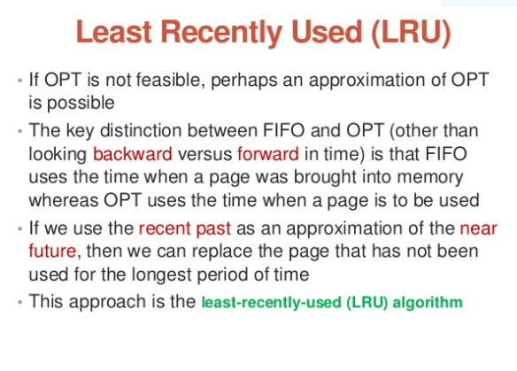

Slide 44
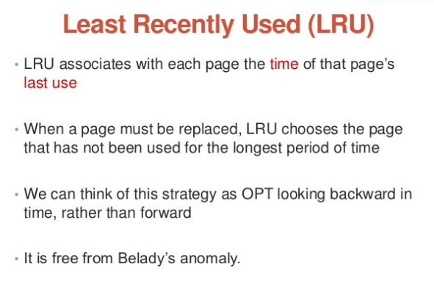

Slide 45
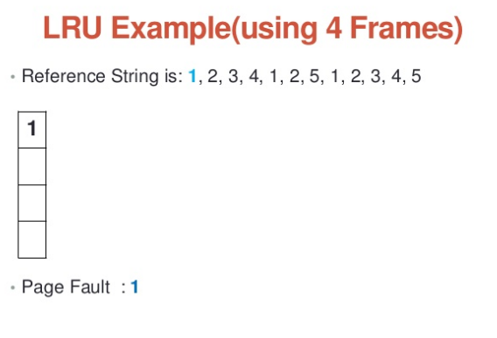

Slide 46
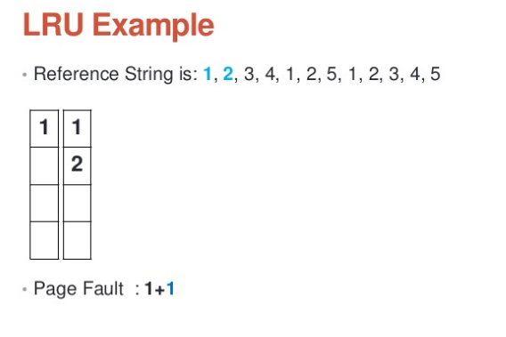

Slide 47
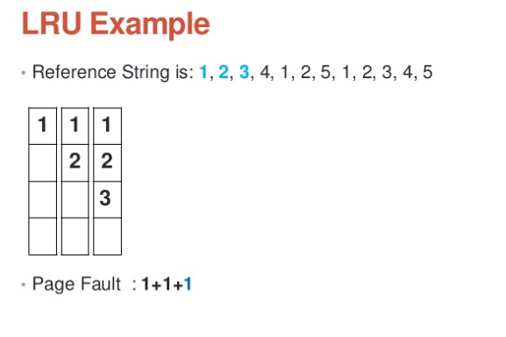

Slide 48
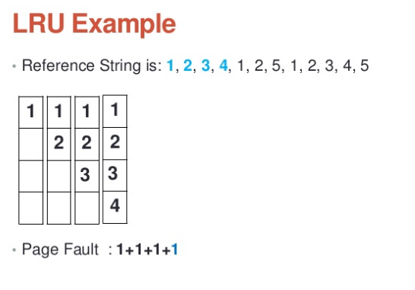

Slide 49
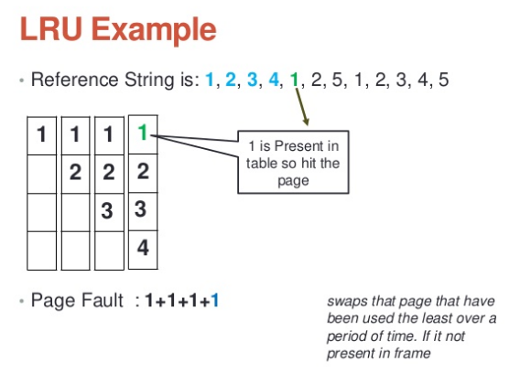

Slide 50
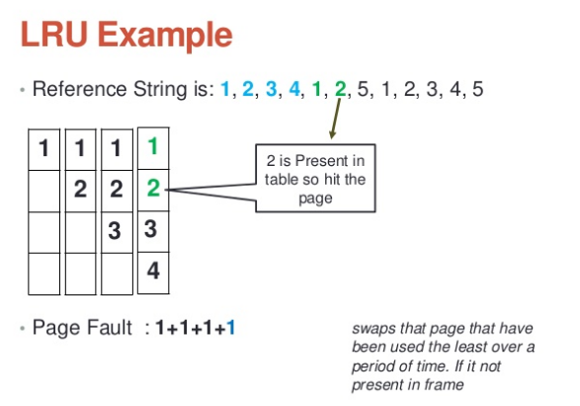

Slide 51
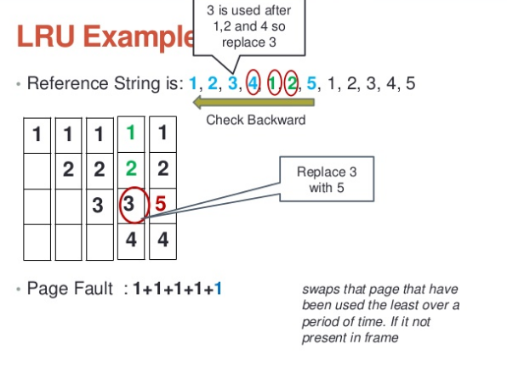

Slide 52
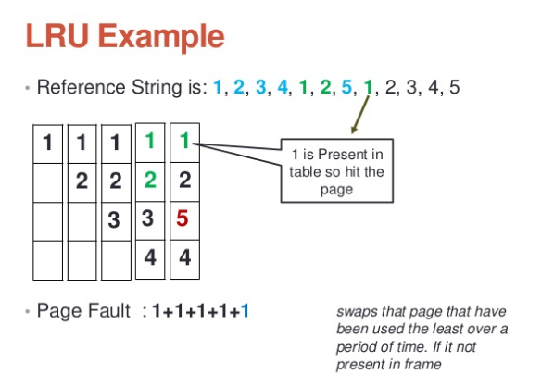

Slide 53
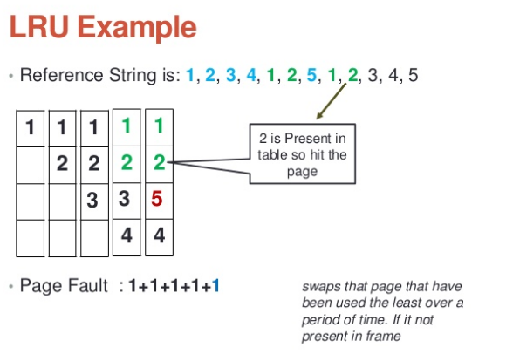

Slide 54
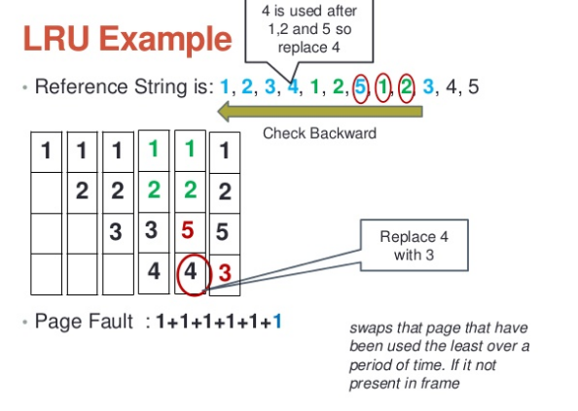

Slide 55
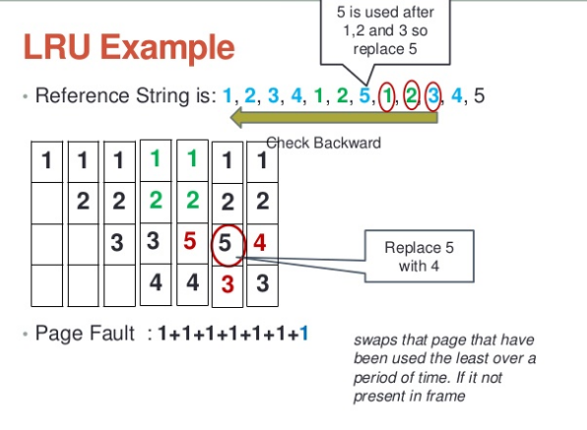

Slide 56
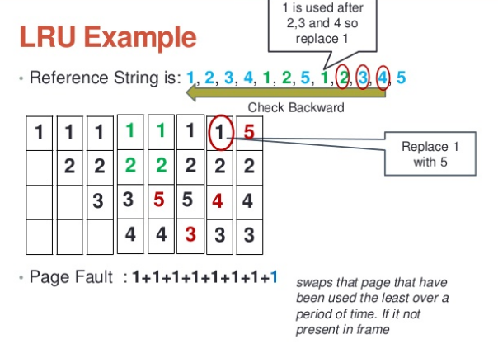

Slide 57
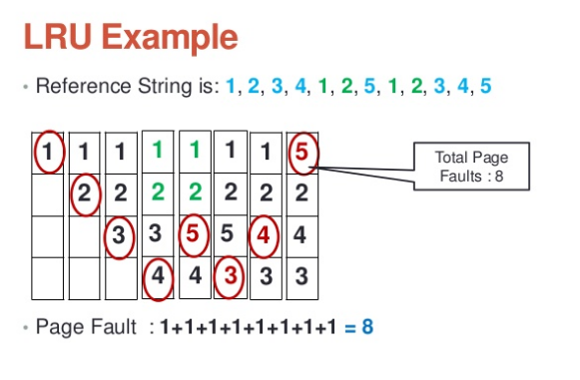

Slide 58
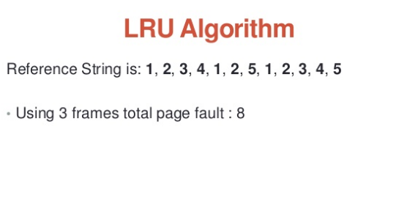

Slide 59
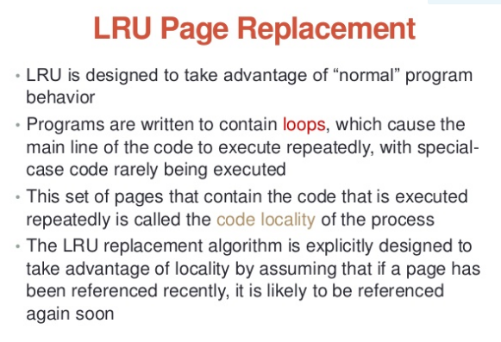

Slide 60
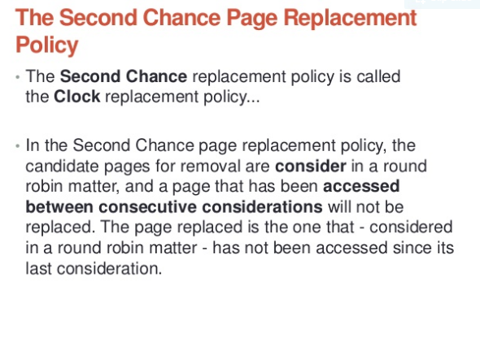

Slide 61
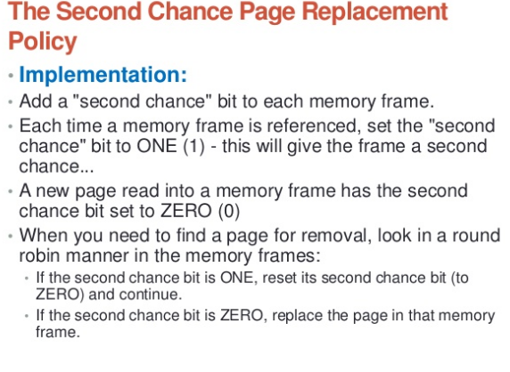

Slide 62
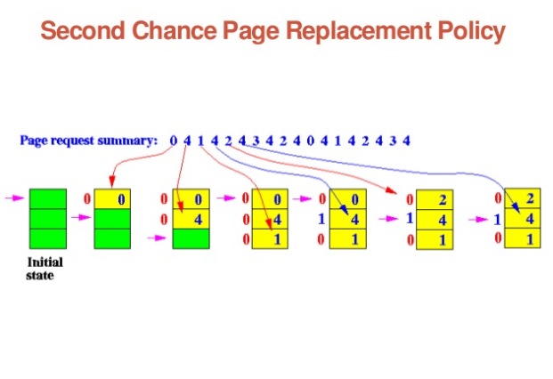

Slide 63


Slide 64


Slide 65


Slide 66
Local v/s Global Page Replacement
“Replacement algorithms can be local or global”
When a process incurs a page fault, a local page replacement algorithm selects for replacement some page that belongs to that same process (or a group of processes sharing a memory partition).
A global replacement algorithm is free to select any page in memory.

Slide 67
Local v/s Global Page Replacement
Local page replacement assumes some form of memory partitioning that determines how many pages are to be assigned to a given process or a group of processes.
The advantage of local page replacement is its scalability: each process can handle its page faults independently without contending for some shared global data structure.

